Slide 1
Employee Data Analysis using Excel
STUDENT NAME:S.POORNEMA
REGISTER NO:312214643
DEPARTMENT:PG &Research Department Of Commerce
USERNAME:asunm1475312214643
COLLEGE: SRI KANYAKA PARAMESWARI ARTS AND SCIENCE COLLEGE FOR WOMEN, CHENNAI,TAMILNADU

Slide 2
PROJECT TITLE
Employee Performance Analysis using Excel

Slide 3


AGENDA
Problem Statement
Project Overview
End Users
Our Solution and Proposition
Dataset Description
Modelling Approach
Results and Discussion
Conclusion
3/21/2024 Annual Review

Slide 4

PROBLEM STATEMENT
A problem statement is a short, clear explanation of an issue or challenge that sums up what you want to change. It helps you, team members, and other stakeholders to focus on the problem, why it's important, and who it impacts. A good problem statement should create awareness and stimulate creative thinking

Slide 5

PROJECT OVERVIEW
A project overview is a detailed description of a project's goals and objectives, the steps to achieve these goals, and the expected outcomes. In addition, a project overview enables you to outline the project schedule, budget, necessary resources, and

Slide 6

WHO ARE THE END USERS?
Human Resources Team
Managers
Executives
Training and Development Teams
Compensation and Benefits Teams
6. Performance Review Committees

Slide 7

OUR SOLUTION AND ITS VALUE PROPOSITION
Flexibility to adapt the analysis to different roles, departments, or performance criteria, ensuring relevance and accuracy in evaluations
Solution Data-driven analysis that support performance reviews, promotions, compensation decisions, and targeted training.
Solutions The ability to analyze both current and historical performance data, with periodic updates to keep information.
Value Proposition Saves time and reduces the risk of human error, ensuring consistent and reliable reporting across the organization.

Slide 8
Dataset Description
EMPLOYEE ID: Unique identifier for each employee in the organization.
FIRST NAME: The first name of the employee.
PAY ZONE: The pay zone or salary band to which the employee's compensation falls.
DEPARTMENT TYPE: The broader category or type of department the employee's work is associated with.
CURRENT EMPLOYEE RATING: The current rating or evaluation of the employee's overall performance.

Slide 9

THE "WOW" IN OUR SOLUTION
While taking pivot count is considered as important so each and every person is considered as COUNT 1.
3/21/2024 Annual Review
9

Slide 10
MODELLING
DATA SET: Kaggle, Employee dataset
FEATURE SELECTION: Slicer, Conditional Formatting, Designing
DATA CLEANING Missing values, Irrelevant data, Correct Errors, Remove Unnecessary Columns and Rows
PIVOT TABLE: Employee ID, First Name, Performance Score.
CHART: Report of Employee Performance based on their Current Ratings is resented as Column Chart
10

Slide 11
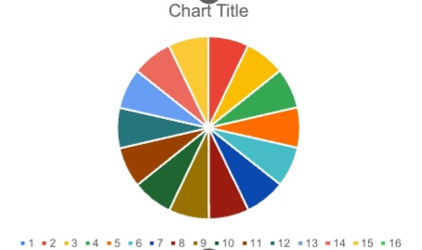
RESULTS
11

Slide 12
conclusion
In conclusion, conducting an employee performance analysis using Excel provides a structured and efficient way to evaluate and track performance metrics. Excel's versatile functions and tools, such as pivot tables, charts, and conditional formatting, allow for clear data visualization and analysis, facilitating informed decision-making. By systematically analyzing performance data, management can identify trends, strengths, and areas for improvement, enabling targeted interventions and fostering a culture of continuous improvement. Regular updates and reviews of this data ensure that performance management remains dynamic and aligned with organizational goals.

